Slide 1
Location Based Management system
Presented By :
BALAJI J
(Reg.no : 20Y005)
Internal Guide: External Guide:
Prof. N.Murali, V.Prabhu,
Assistant Professor, Technical Lead,
Department Of Computer Application, AstroWeb Solutions,
Thiagarajar College Of Engineering Simmakkal,
Madurai. Madurai.

Slide 2
SYNOPSIS
About the organization
Abstract
Introduction
Proposed System
Modules
Gantt Chart and Architectural Design
ER Diagram, DFD, Use Case Diagram
Expected Outcomes
References

Slide 3
ABOUT THE ORGANIZATION
AstroWebSolution is a software company in Madurai that expertise in custom design and apps development services.
Mission
Our mission is to provide innovative software solutions for excellence and enterprise enterprise compliance.
Vision
Our vision is to become businesses’ first choice when it comes to software development and maintenance. To accomplish this, we always try to exceed our client’s expectations. AstroWebSolution strives to build lasting partnerships and ensures client satisfaction.

Slide 4
abstract
A Generic UI Design to enter the new records with different components required for a specific location.

Slide 5
Introducton
User Interface plays major role in interaction with Users.
Users usually want a view which is more comfortable and easy access to everything.
To incorporate all these, a comparative study was done on websites such as Google Maps, Bing Maps, Mapquests etc based on standard metrics

Slide 6
Proposed System
The motive of the proposed system is to provide a suggestion-based system determines the similarity to users or items and produces a prediction for the user by taking the weighted average of all the ratings.
Therefore, we use some indexes which are appropriate to evaluate our approaches, such direction, Contact information ,reviews, updates. Then, we design several evaluation methods to analyze performance.
To predict a rating for an place,we calculate the overall review such as like comments. This enables users to find not only content items they are currently interested in, but also those in which they might become interested.

Slide 7
modules
ADMIN MODULE - Deals with login page UX design template.
DASHBOARD - It deals with the details of how many listings have published and how many of them are in pending.
EDIT PROFILE – It is used to change the gmail and phone number.
CHANGE PASSWORD – Used to change the current password to a new one.
MY LISTING – It is used to show all the listings that the admin has entered and the listings that are published.
SUBMIT LISTING - This Module needs informations about a specific place like Title, Description, Logo, Location, Latitude and Longitute for a place provided by using map, Details, Social Media Links and Gallery

Slide 8
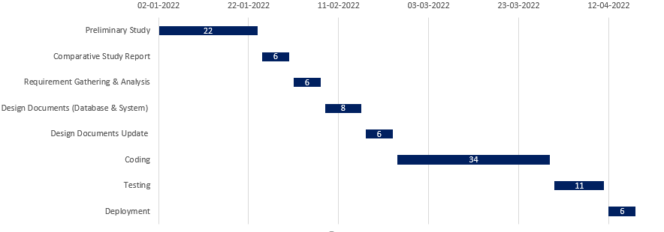
GANTT CHART

Slide 9
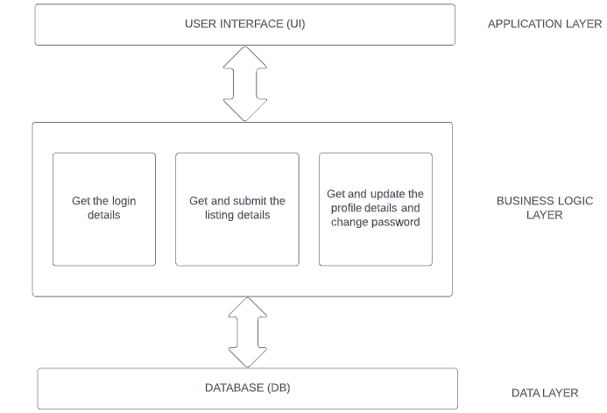
ARCHITECTURAL DESIGN

Slide 10
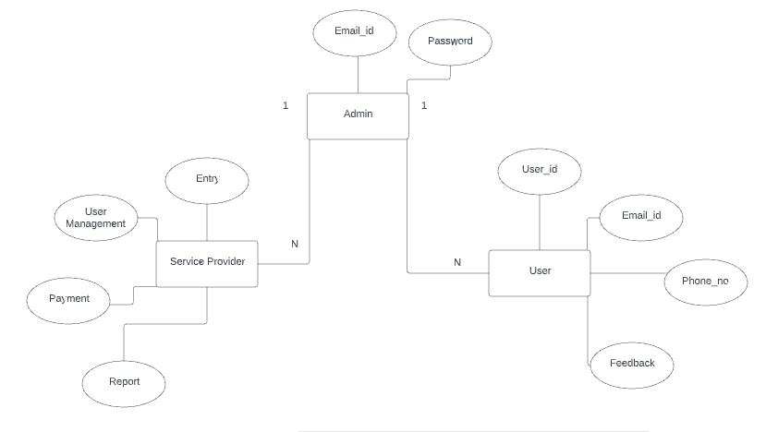
ER DIAGRAM

Slide 11
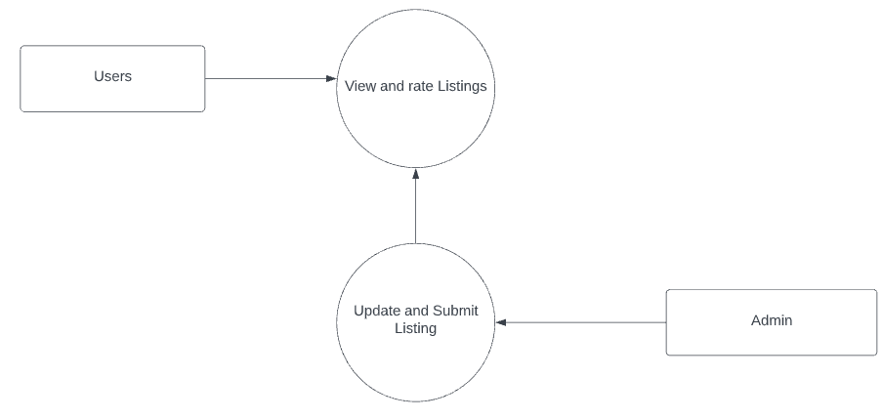
DFD LEVEL 0

Slide 12
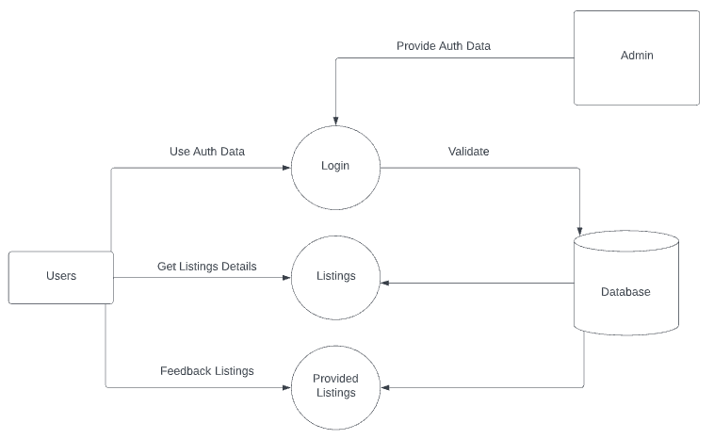
DFD LEVEL 1

Slide 13
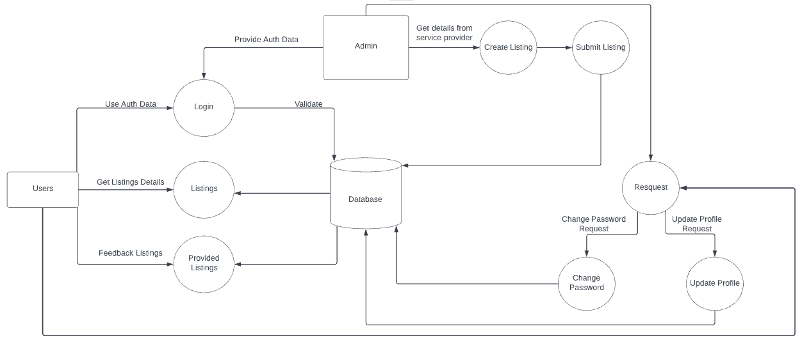
DFD LEVEL 2

Slide 14
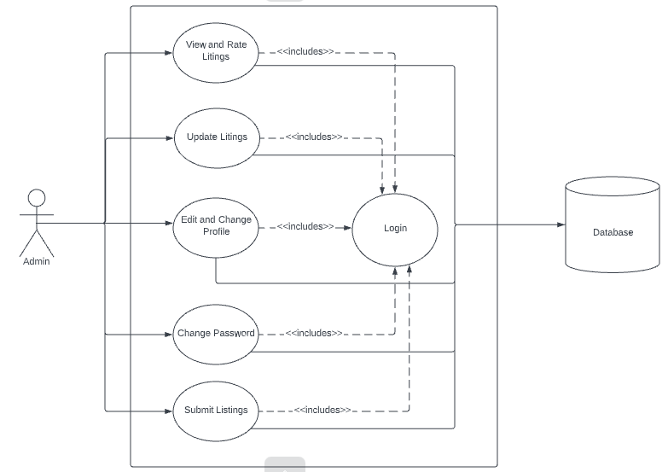
USE CASE DIAGRAM

Slide 15
EXPECTED OUTCOMES
User friendly way to submit all the information needed for a record and a platform to access all the listing by admin.

Slide 16
REFERENCES
https://codeigniter.com/userguide3/tutorial/index.html
https://astrowebsolution.com
https://lucid.app

